Slide 1

INDIAN PREMIER LEAGUE
IPL VISUALIZATION
BY: Aman Patel
ID: 015959372

Slide 2
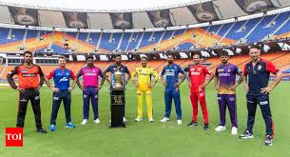
INTRODUCTION
India's professional Twenty20 cricket league is called the Indian Premier League (IPL). The inaugural season took place in 2008, following its founding by the Board of Control for Cricket in India (BCCI) in 2007.
It is One of the most well-liked and successful cricket leagues worldwide, the IPL has grown rapidly. The league consists of franchise clubs from various Indian towns and regions.

Slide 3
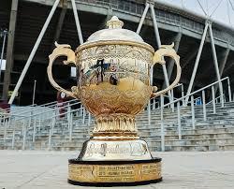
WHY?
Currently each and every field requires analysis of their data, which can be used to increase their future outcome. Thus, it goes same for sports as well.
01
Insights on effective player combinations, strategies, and the effects of many elements on a team's success can be gained by visualizing team performance, strategies, and dynamics.
02
Coaches and teams may find visualization useful that examine and contrast a player's performance over several seasons, assisting in the identification of trends, patterns, and areas in need of development.
03
One of the most well-liked and extensively followed cricket leagues in the world is the IPL. Cricket aficionados, and fans can all be drawn in by creating visualizations using IPL data.
04

Slide 4
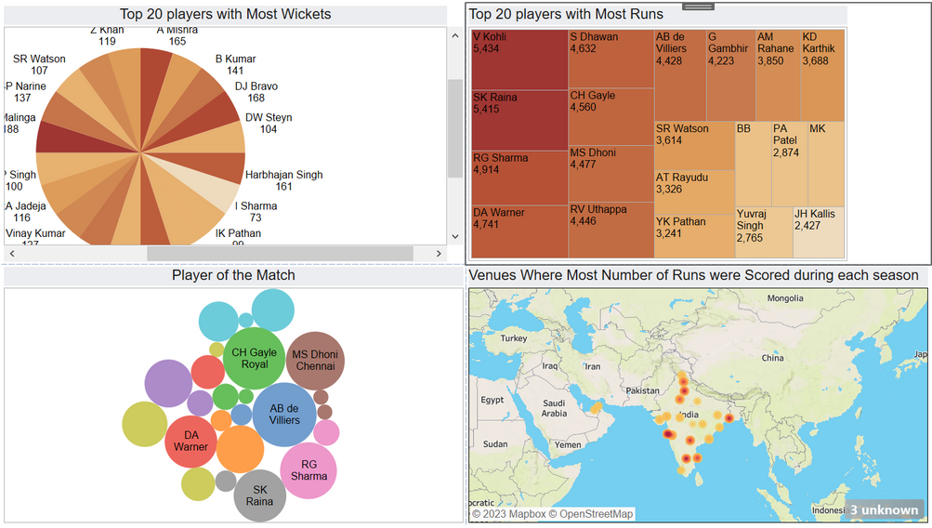
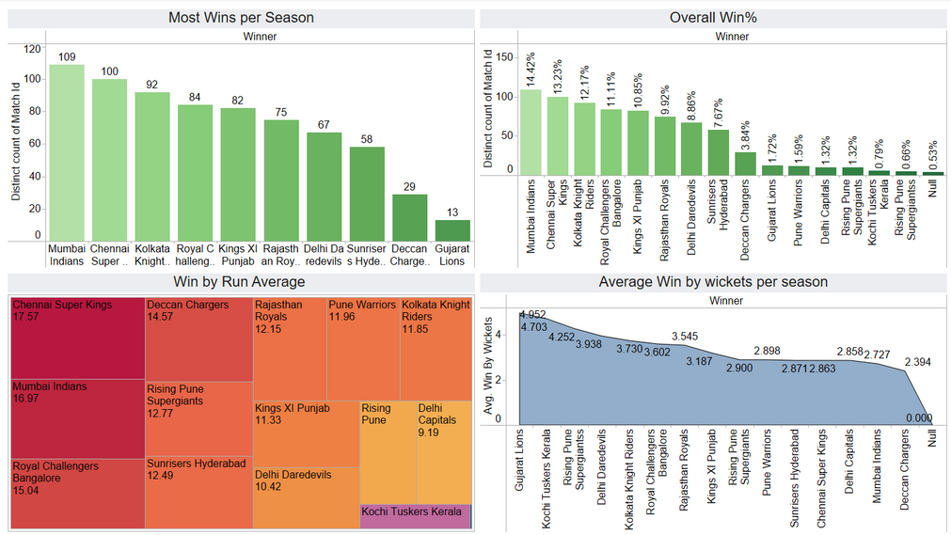
WHAT ANALYSIS ARE DONE
PLAYERS WITH MOST WICKETS
PLAYERS WITH MOST RUNS
TEAM WITH MOST WINS EACH SEASON
TEAM WITH HIGH WIN CHANCES
AVG OF TEAM WITH WICKETS IN EACH SEASON
PLAYER WITH MOST NUMBER OF MVP
VENUE WITH WITH THEIR HIGHEST RUN SCORERS
TEAM WITH WIN BY HIGH MARGIN
TOSS DECISION WITH WIN %
IMPACT OF TOSS ON WIN & LOSS

Slide 5
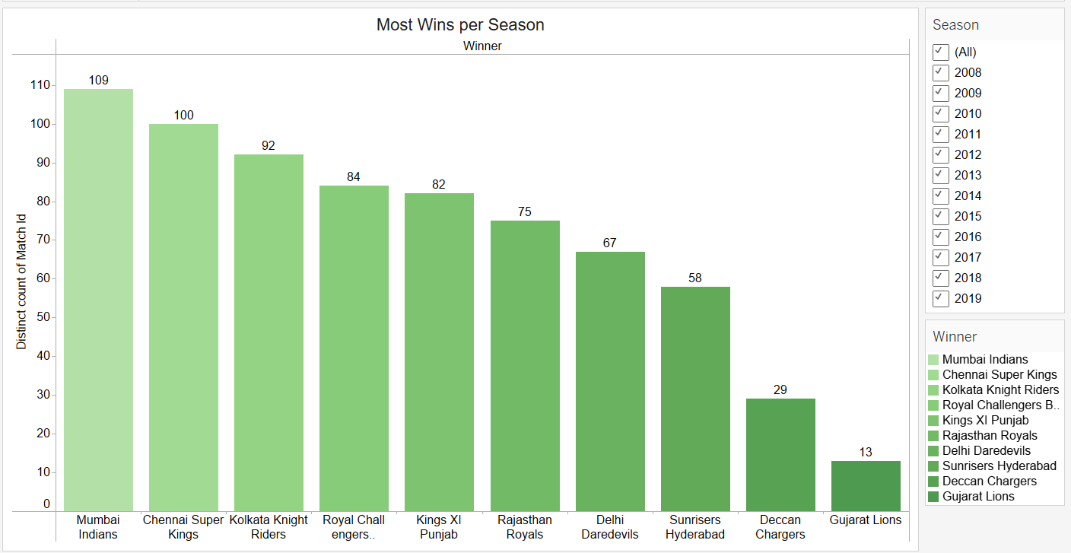
MOST WINS FOR EACH FRANCHISE IN PARTICULAR SEASON

Slide 6
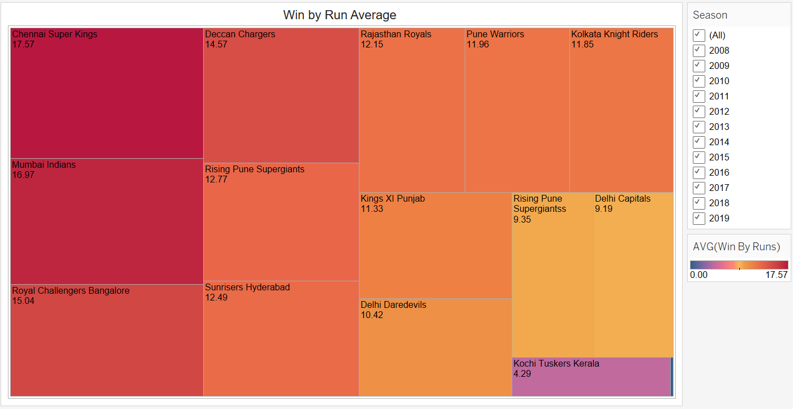
TEAMS WITH THEIR WINNING AVERAGE BY RUNS

Slide 7
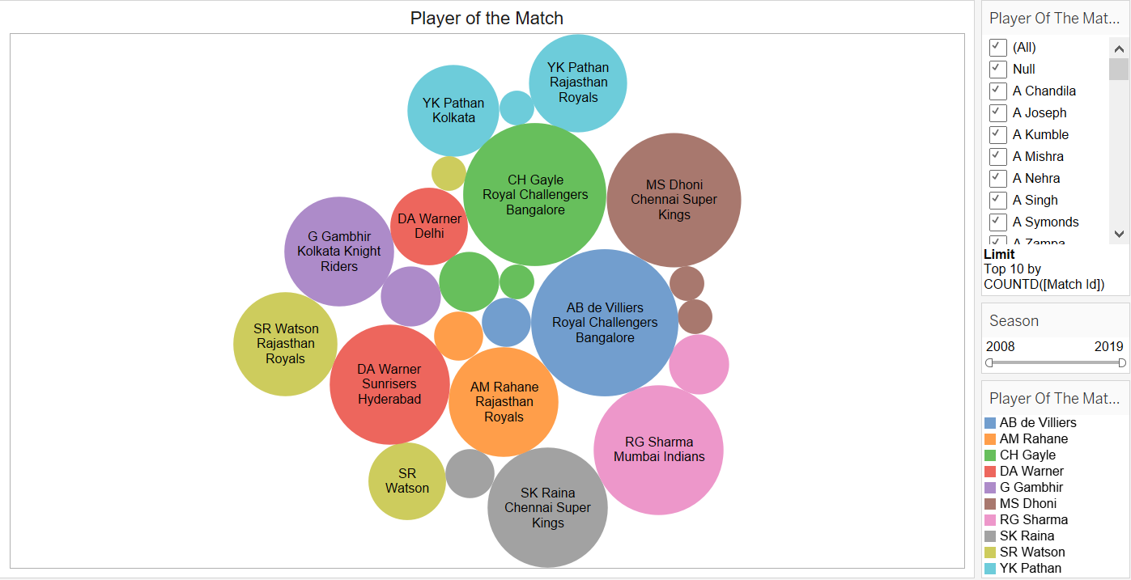
PLAYER FROM EACH TEAM WITH MOST NUMBER OF MVP’S

Slide 8
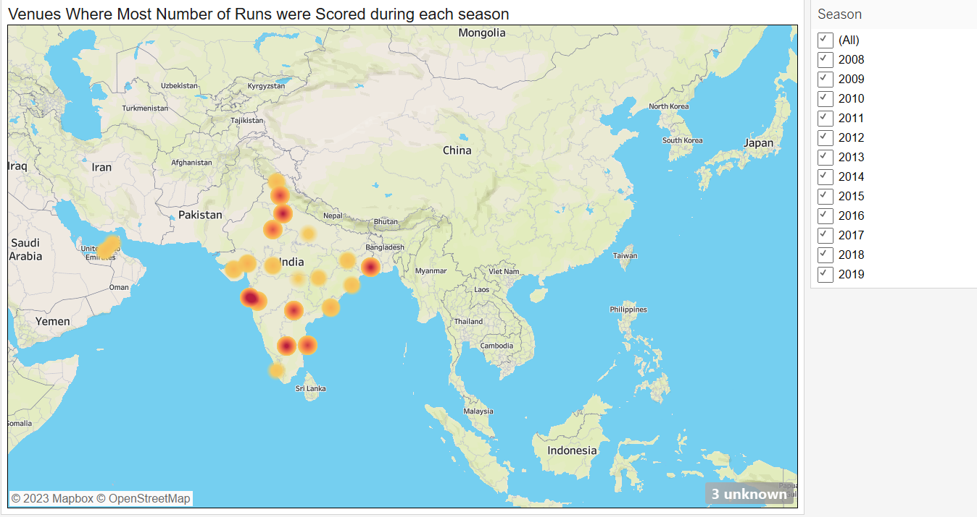
STADIUM OR VENUES WITH HIGHEST RUNS SCORED IN EACH IPL SEASON

Slide 9
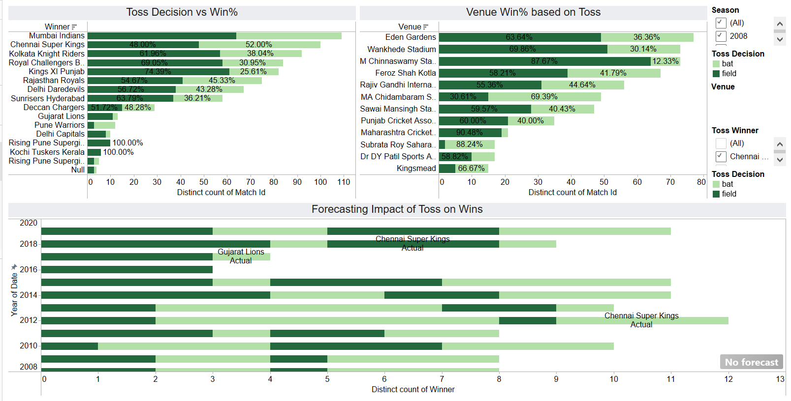
VARIOUS PLOTS SHOWING IT’S IMPACT OVER TOSS WINS

Slide 10
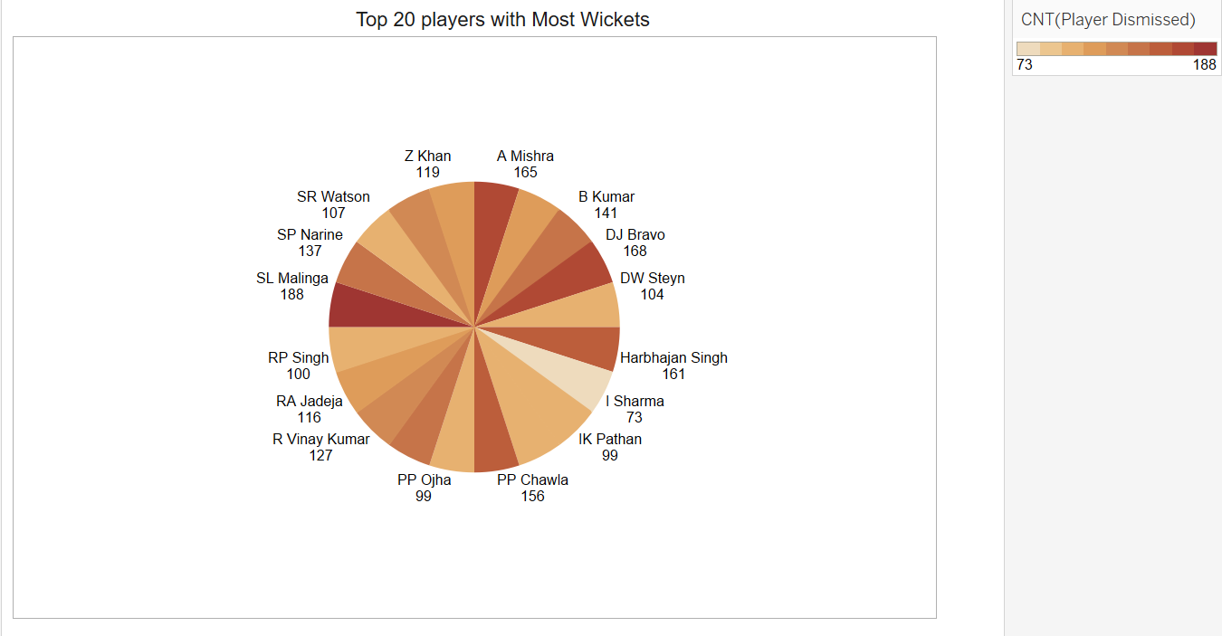
TOP 20 PLAYER WITH HIGHEST WICKETS IN IPL

Slide 11
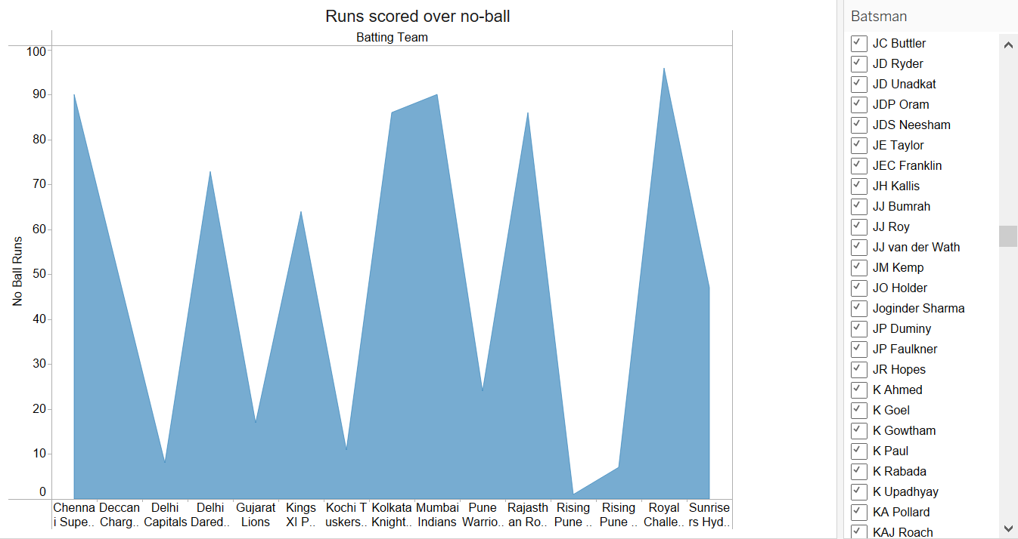
TEAMS WITH HIGHEST NUMBER OF RUNS IN NO-BALLS

Slide 12
FUTURE SCOPE
Deploy machine learning techniques to forecast player performances, important data, and match results.
Would create dynamically updated interactive dashboards that give spectators real-time information about player statistics, team tactics, and match dynamics is recommended.
Make interactive platforms that let fans interact and examine IPL information. Look at how to include IPL data visualizations into social media networks.
Expand the visualization's range to examine the relationships between the IPL's performance indicators and those of other cricket leagues or even sports.
MORE INFORMATION

Slide 13
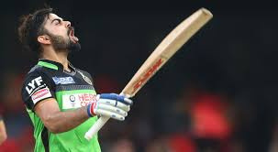
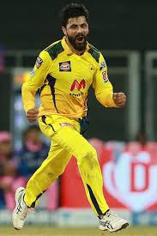
THANK YOU

